Slide 1
Problem Statement
Innovative Monitoring System for TeleICU Patients Using Video Processing and Deep Learning
Design and develop an Innovative Monitoring System for TeleICU Patients that utilizes advanced video processing techniques and deep learning algorithms to monitor patient activities, vital signs, and potential health risks in real-time. The system should be capable of accurately detecting and analyzing patient movements, facial expressions, and physiological indicators from live video streams, providing diagnostic insights to healthcare providers to enhance remote patient monitoring and intervention strategies.

Slide 2
Idea Brief (Solution)
The Innovative Monitoring System for TeleICU Patients utilizes advanced video processing and deep learning technologies to provide real-time monitoring and analysis of patient activities and vital signs. By integrating with existing TeleICU setups, the system captures live video feeds and applies sophisticated algorithms to detect movements, analyze facial expressions, and monitor physiological parameters.
This data is processed in real-time to identify anomalies and trends indicative of patient health status. The system ensures secure data transmission and scalability, making it adaptable to diverse TeleICU environments and enhancing the efficiency and effectiveness of remote patient monitoring.

Slide 3
Features Offered
Real-Time Video Analysis: Utilizes advanced video processing algorithms to analyze live video streams from TeleICU patient environments.
Activity Recognition: Detects and monitors patient activities such as movement patterns, posture changes, and bed exits to assess patient condition and activity levels.
Predictive Analytics: Leverages historical data and machine learning models to predict potential health deterioration or critical events, enabling proactive interventions.
Vital Signs Monitoring: Integrates with sensors or video-based techniques to monitor vital signs such as heart rate, respiratory rate, and oxygen saturation.
Anomaly Detection: Utilizes deep learning models to detect anomalies in patient behavior or vital signs, alerting healthcare providers to potential health risks.
Predictive Analytics: Leverages historical data and machine learning models to predict potential health deterioration or critical events, enabling proactive interventions.

Slide 4
Process flow
1. Data Collection & Preprocessing:
Data Collection: Gathered video data from various series setups
Preprocessing: Extracted frames, resized them to a standard format (e.g., 416x416), and organized them into training, validation, and test sets.
2. Object Detection Model Development:
Model Selection: We choose YOLO (You Only Look Once) for efficient real-time object detection of the medical staff.
Training: We utilized TensorFlow to train YOLO on annotated datasets, optimizing for accuracy and speed.
3. Motion Detection Model Development:
Custom Dataset: We developed a motion detection model using a custom dataset specific to TeleICU environments.
Training: We trained the motion detection model using OpenCV , focusing on detecting patient movements or anomalies.

Slide 5
4. Evaluation & Testing: Object Detection Model Evaluation: Assessed performance metrics (accuracy, precision, recall) on validation datasets. Motion Detection Model Testing: Validated model robustness and effectiveness in detecting critical motions in TeleICU settings. 5. Deployment Preparation: Model Conversion: Converted trained TensorFlow models to optimized formats (e.g., TensorFlow Lite). Integration: We integrate both models seamlessly into existing TeleICU systems, ensuring compatibility and efficiency.

Slide 6
6. Deployment: Deployment Process: Implement the object detection and motion detection models in live TeleICU environments, ensuring real-time functionality and accuracy. Monitoring: We establish monitoring protocols to track the performance of both models continuously. 7. Maintenance & Updates: Maintenance: Regularly update model weights and configurations based on ongoing data and user feedback for both models. Continuous Improvement: Iteratively improve both models through retraining and adaptation to enhance performance and address emerging challenges.

Slide 7
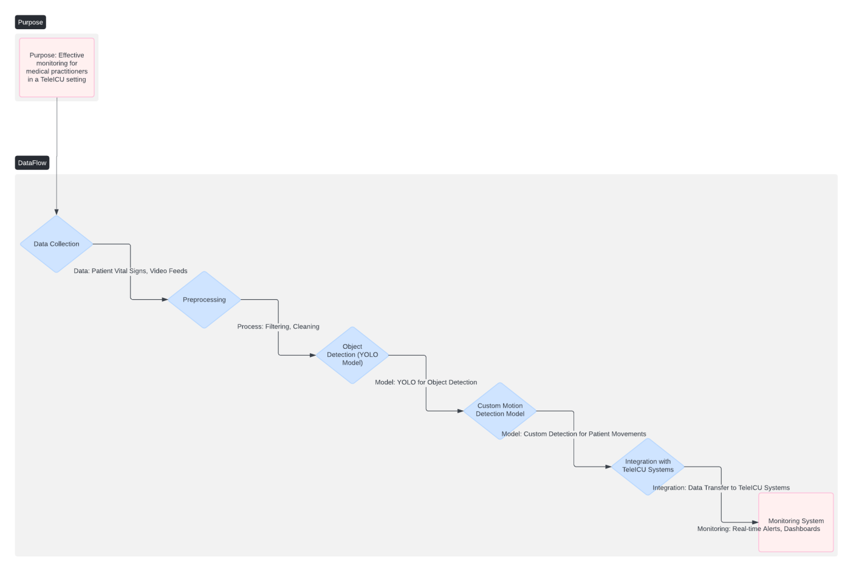
Architecture Diagram
High Level Overview Diagram

Slide 8
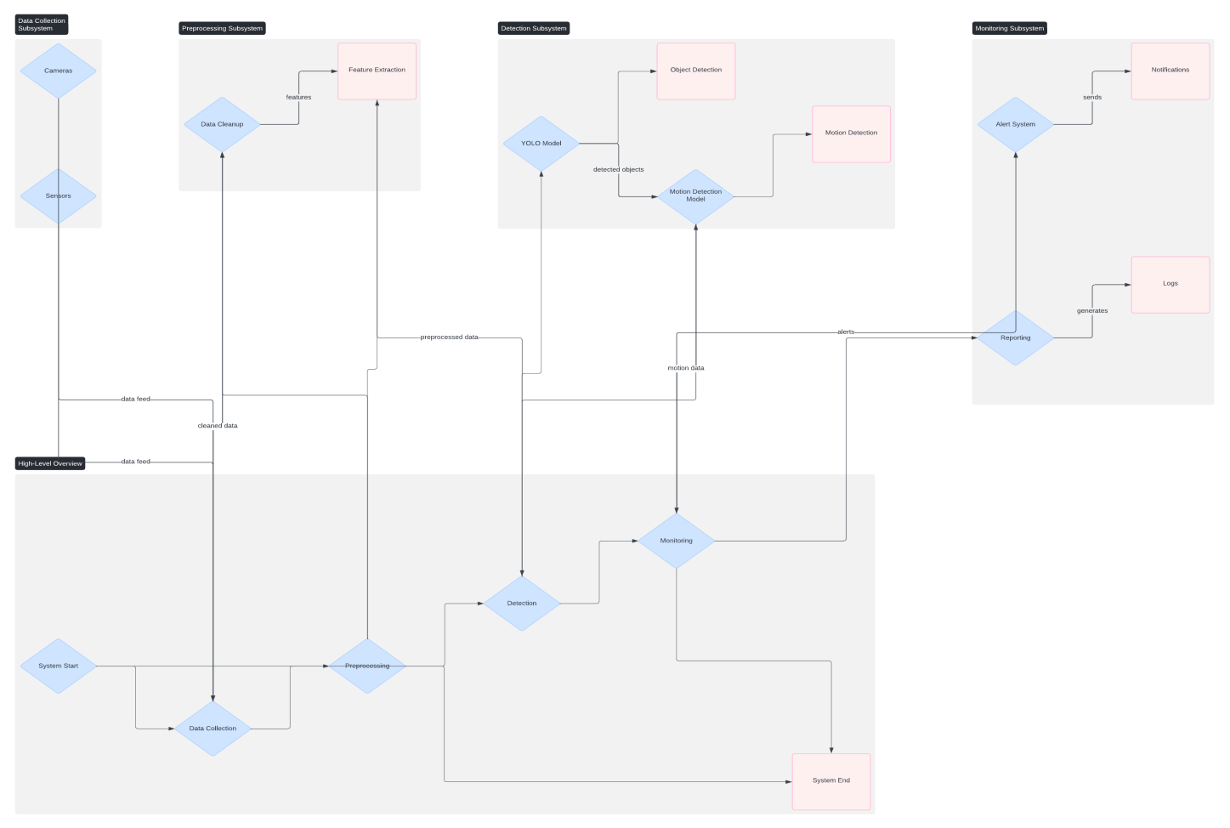
Component Diagram

Slide 9
Technologies used
List of dependencies:
Python: Version 3.6 or higher.
TensorFlow: Deep learning framework for training and inference.
OpenCV: Library for computer vision tasks, including image and video processing.
YOLO (You Only Look Once): Object detection model and associated configuration files.
PASCAL VOC format: Dataset annotation format for object detection tasks.Other Python libraries: Potentially NumPy, Matplotlib, Pandas, etc., depending on specific needs (e.g., data handling, plotting).
LabelBox : For annotating the objects in the video

Slide 10
Prerequisites:
Operating System: Compatible with Windows, macOS, or Linux.
Hardware: Depending on the scale of your project, a GPU may be recommended for faster training with TensorFlow (NVIDIA GPU with CUDA support).
Software: Python environment set up with necessary packages (pip, virtualenv, or conda for managing Python environments).CUDA and cuDNN (if using GPU acceleration).IDE or text editor of choice for development (e.g., PyCharm, Visual Studio Code).

Slide 11
Team members and contribution:
Punya G K - Dataset (Object Detection)
Thomas Varghese - Dataset (Motion Detection)
Aleeta Timothy - Object Detection Model
Yacha Harshini - Motion Detection Model

Slide 12
Conclusion
The Innovative Monitoring System for TeleICU Patients represents a significant advancement in remote patient monitoring, leveraging cutting-edge video processing and deep learning technologies. By continuously analyzing live video streams and patient data, the system enhances healthcare providers' ability to monitor patient activities, detect anomalies, and intervene proactively. This proactive approach not only improves patient outcomes by enabling timely interventions but also optimizes healthcare delivery by reducing response times and enhancing resource allocation. With its secure data transmission, user-friendly interface, and scalability across different TeleICU setups, the system sets a new standard in remote patient monitoring, paving the way for more personalized and effective care in critical care environments.

